Slide 1
Routing Algorithms
The routing algorithm is that part of the network layer software responsible for deciding which output line an incoming packet should be transmitted on.
The goal of a routing algorithm is in general dictated by the requirement of the communication network and the service it provides as well as any additional or specific goals a service provider wants to impose on itself
Routing protocols are mechanisms by which routing information is exchanged between routers so that routing decisions can be made.
Routing is a process in which the layer-3/ Network Layer devices find the optimal path to deliver a packet from one network to another.
Router has two processes to perform : Routing and Forwarding
Forwarding: It handles each packet as it arrives, looking up the outgoing line to use for it in the routing tables.
Routing Algorithm is responsible for filling in and updating the routing tables.

Slide 2
Desirable Properties
Properties of a routing algorithm: correctness, simplicity, robustness, stability, fairness, and efficiency.
Correctness: The algorithm should get packets eventually to the correct destination
Simplicity: The routing should be done in a simple manner so that the overhead is as low as possible. With increasing complexity of the routing algorithms the overhead also increases
Robustness: The algorithm should be able to handle new routers coming online, as well as, handle other going off or malfunctioning.
Stability: The algorithm under constant conditions should converge to some equilibrium.
Fairness: Fairness ensures that all users receive a fair share of network resources. An algorithm should avoid favoring specific routes or users disproportionately.
Efficiency: Efficiency minimizes overhead and optimizes resource utilization. Efficient algorithms reduce latency and maximize throughput.
Fairness and Efficiency are hard to satisfy simultaneously.

Slide 3
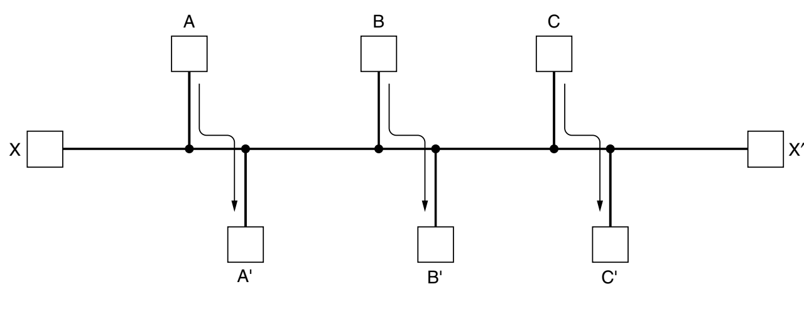
Routing Traffic
Example: Suppose that there is enough traffic between A and A′, between B and B′, and between C and C′ to saturate the horizontal links. To maximize the total flow, the X to X′ traffic should be shut off altogether. Unfortunately, X and X′ may not see it that way. Evidently, some compromise between global efficiency and fairness to individual connections is needed.
Goals could be to minimize delay, maximize throughput, minimize the amount of the amount of bandwidth consumed per packet.

Slide 4
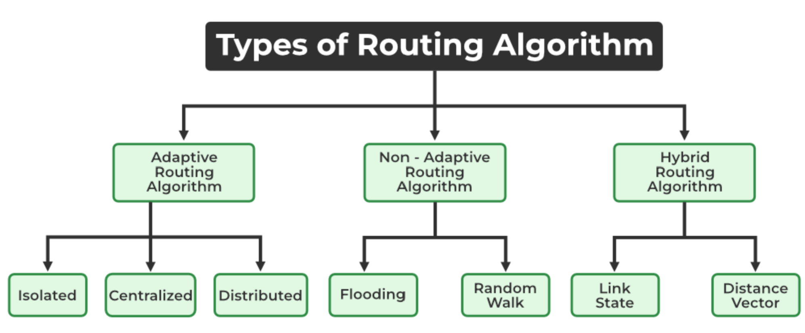
Types of Routing Algorithm

Slide 5
Types of Routing Algorithm
Nonadaptive algorithms: do not base their routing decisions on any measurements or estimates of the current topology and traffic. Instead, the choice of the route to use to get from I to J (for all I and J) is computed in advance, offline, and downloaded to the routers when the network is booted. This procedure is sometimes called static routing.
Adaptive algorithms :in contrast, change their routing decisions to reflect changes in the topology, and sometimes changes in the traffic as well. These dynamic routing algorithms differ in where they get their information (e.g., locally, from adjacent routers, or from all routers), when they change the routes (e.g., when the topology changes, or every ΔT seconds as the load changes), and what metric is used for optimization (e.g., distance, number of hops, or estimated transit time).
Hybrid Algorithms are a combination of both adaptive and non-adaptive algorithms. In this approach, the network is divided into several regions, and each region uses a different algorithm.

Slide 6
Non Adaptive Routing Algorithms
Flooding: This adapts the technique in which every incoming packet is sent on every outgoing line except from which it arrived. One problem with this is that packets may go in a loop and as a result of which a node may receive duplicate packets. These problems can be overcome with the help of sequence numbers, hop count, and spanning trees.
Random walk: In this method, packets are sent host by host or node by node to one of its neighbors randomly. This is a highly robust method that is usually implemented by sending packets onto the link which is least queued.

Slide 7
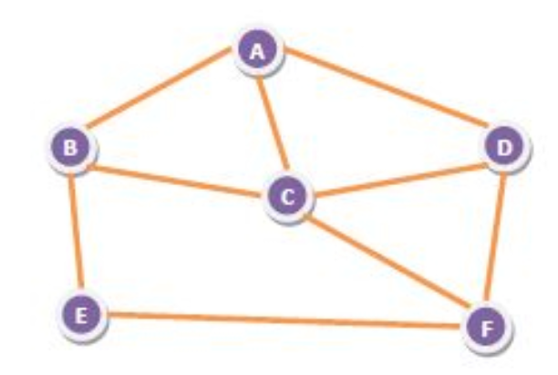
Flooding
Flooding is a non-adaptive routing technique following this simple method: when a data packet arrives at a router, it is sent to all the outgoing links except the one it has arrived on.
For example, let us consider the network in the figure, having six routers that are connected through transmission lines.
An incoming packet to A, will be sent to B, C and D.
B will send the packet to C and E.
C will send the packet to B, D and F.
D will send the packet to C and F.
E will send the packet to F.
F will send the packet to C and E.

Slide 8
Types of flooding
Uncontrolled flooding − Here, each router unconditionally transmits the incoming data packets to all its neighbors.
Controlled flooding − They use some methods to control the transmission of packets to the neighboring nodes. The two popular algorithms for controlled flooding are Sequence Number Controlled Flooding (SNCF) and Reverse Path Forwarding (RPF).
Selective flooding − Here, the routers don't transmit the incoming packets only along those paths which are heading towards approximately in the right direction, instead of every available paths.

Slide 9
Flooding
Advantages of Flooding :
It is very simple to setup and implement, since a router may know only its neighbors.
It is extremely robust. Even in case of malfunctioning of a large number routers, the packets find a way to reach the destination.
All nodes which are directly or indirectly connected are visited. So, there are no chances for any node to be left out. This is a main criteria in case of broadcast messages. The shortest path is always chosen by flooding.
Disadvantages of Flooding :
Flooding tends to create an infinite number of duplicate data packets, unless some measures are adopted to damp packet generation.
It is wasteful if a single destination needs the packet, since it delivers the data packet to all nodes irrespective of the destination.
The network may be clogged with unwanted and duplicate data packets. This may hamper delivery of other data packets.

Slide 10
Adaptive Routing Algorithms
Isolated: In this method each, node makes its routing decisions using the information it has without seeking information from other nodes. The sending nodes don’t have information about the status of a particular link. The disadvantage is that packets may be sent through a congested network which may result in delay.
Examples: Hot potato routing and backward learning.
Centralized: In this method, a centralized node has entire information about the network and makes all the routing decisions. The advantage of this is only one node is required to keep the information of the entire network and the disadvantage is that if the central node goes down the entire network is done. The link state algorithm is referred to as a centralized algorithm since it is aware of the cost of each link in the network.
Distributed: In this method, the node receives information from its neighbors and then takes the decision about routing the packets. A disadvantage is that the packet may be delayed if there is a change in between intervals in which it receives information and sends packets. It is also known as a decentralized algorithm as it computes the least-cost path between source and destination.

Slide 11
Hybrid Algorithms
Link-state: In this method, each router creates a detailed and complete map of the network which is then shared with all other routers. This allows for more accurate and efficient routing decisions to be made.
Distance vector: In this method, each router maintains a table that contains information about the distance and direction to every other node in the network. This table is then shared with other neighboring routers in the network. The disadvantage of this method is that it may lead to routing loops.

Slide 12
The Optimality Principle
It states that if router J is on the optimal path from router I to router K, then the optimal path from J to K also falls along the same route.
Assume part of the route from I to J is r1 and the rest of the route r2. If a route better than r2 existed from J to K, it could be concatenated with r1 to improve the route from I to K, contradicting our statement that r1r2 is optimal.
As a direct consequence of the optimality principle, we can see that the set of optimal routes from all sources to a given destination form a tree rooted at the destination. Such a tree is called a sink tree.
Consider a network of routers, {G, H, I, J, K, L, M, N} as shown in the figure. Let the optimal route from I to K be as shown via the green path, i.e. via the route I-G-J-L-K. According to the optimality principle, the optimal path from J to K with be along the same route, i.e. J-L-K.

Slide 13
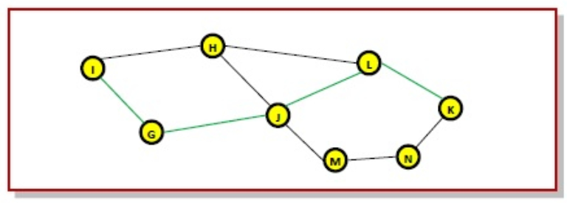
The Optimality Principle
Consider a network of routers, {G, H, I, J, K, L, M, N} as shown in the figure. Let the optimal route from I to K be as shown via the green path, i.e. via the route I-G-J-L-K. According to the optimality principle, the optimal path from J to K with be along the same route, i.e. J-L-K.

Slide 14
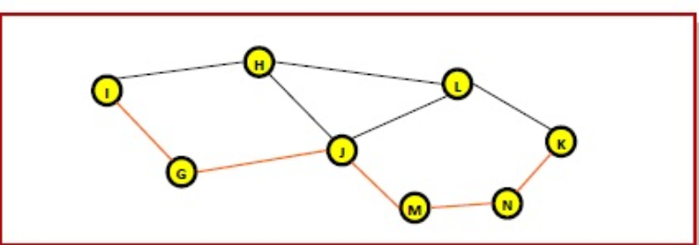
The Optimality Principle
Now, suppose we find a better route from J to K is found, say along J-M-N-K. Consequently, we will also need to update the optimal route from I to K as I-GJ- M-N-K, since the previous route ceases to be optimal in this situation. This new optimal path is shown line orange lines in the following figure.

Slide 15
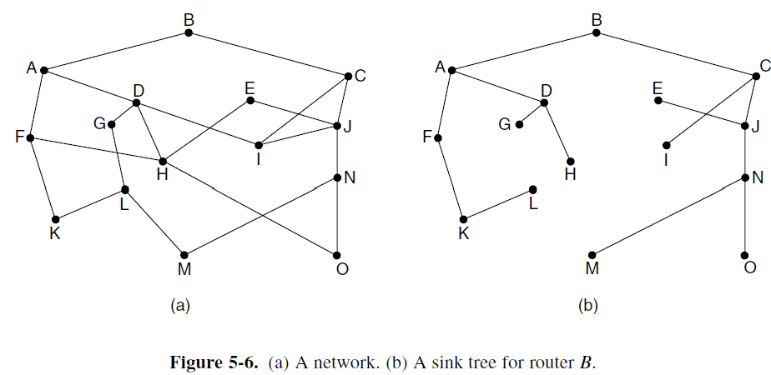
A Network and Sink Tree
Distance Metric is number of hops.
Note that a sink tree is not necessarily unique; other trees with the same path lengths may exist. If we allow all of the possible paths to be chosen, the tree becomes a more general structure called a DAG (Directed Acyclic Graph). DAGs have no loops.

